Slide 1
Lab 7b
Rachel herman and matt Ernst
EECT 112
4/7/17

Slide 2
Objective:
This lab, #7b, is intended to introduce the students to be more comfortable of using the lab equipment, the logic designer, the test equipment, and of course the TTL chips. Most of all you’ll learn more about the design and redesign of logic circuits.

Slide 3
Procedure:
Use the existing Problem 3-43 on page143 in the text book that we did on week 7, answer provided on Lab 7a.
1. Use Multisim to draw a new redesign logic circuit show in figure 1
2. Simulate Figure 1 for each voltage level and record in Table 1.
3. Then implement results on the breadboard for testing and measuring each voltage level.
4. Record in Table 1
5. Conclusion
Reminder: Select two 1 kΩ resistors and measure and record the resistance of each.

Slide 4
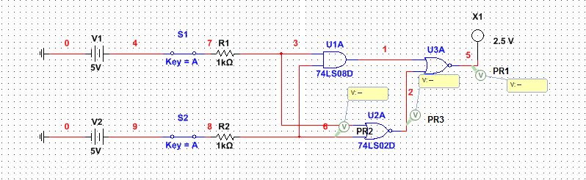
Multisim:

Slide 5
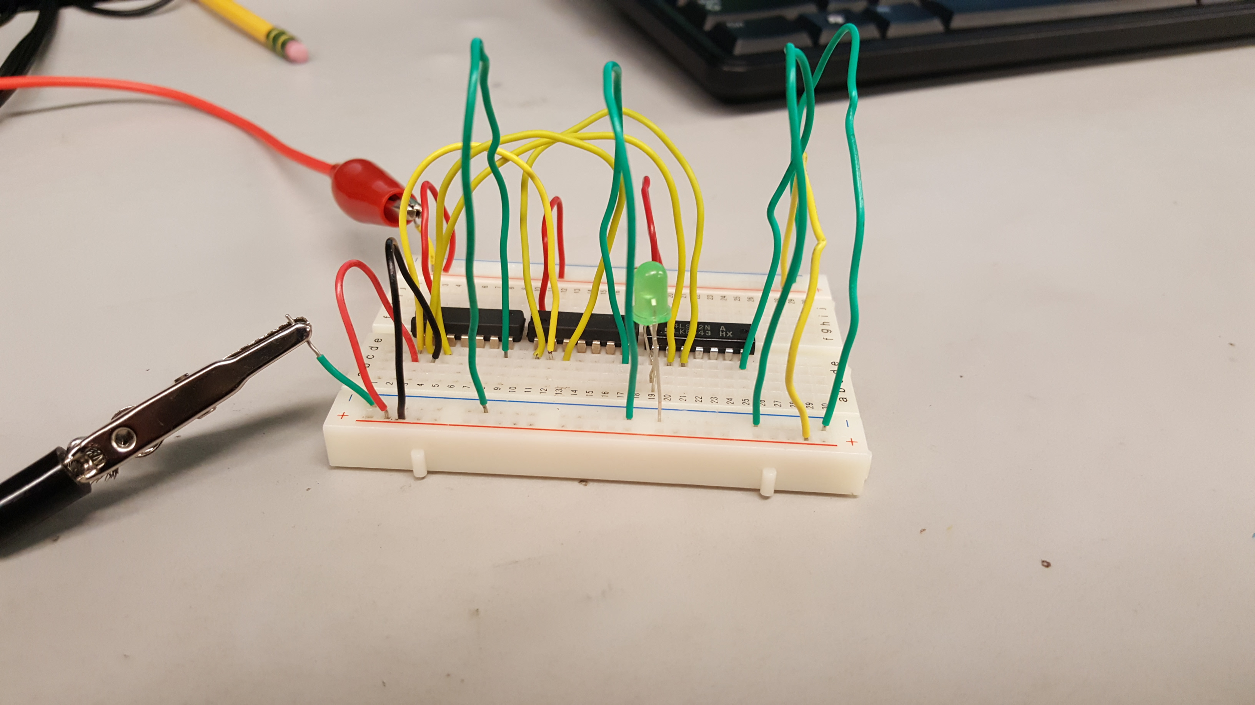
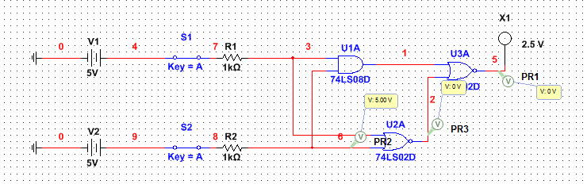
1-1

Slide 6
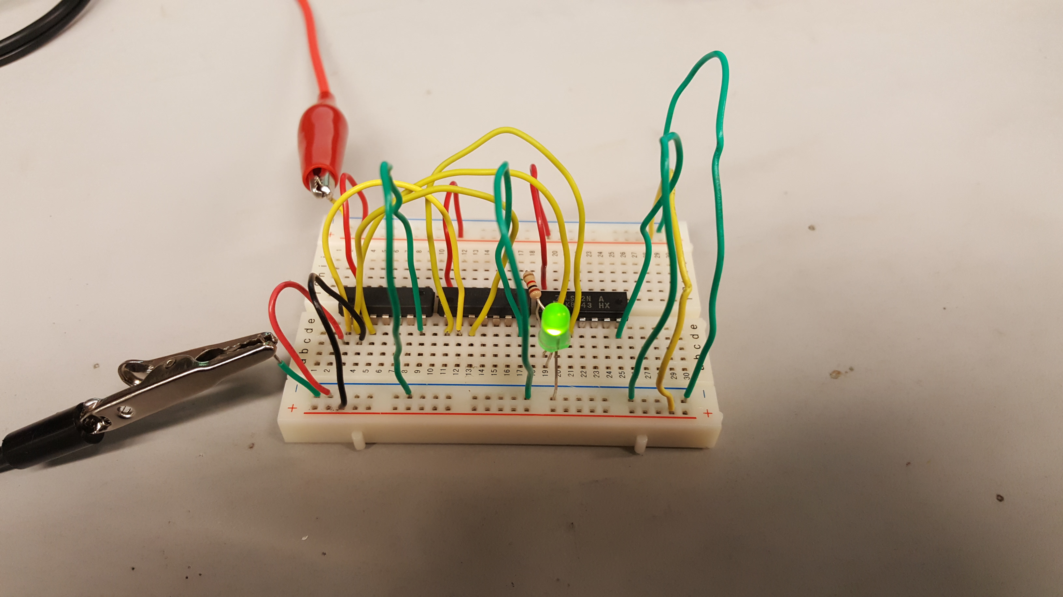
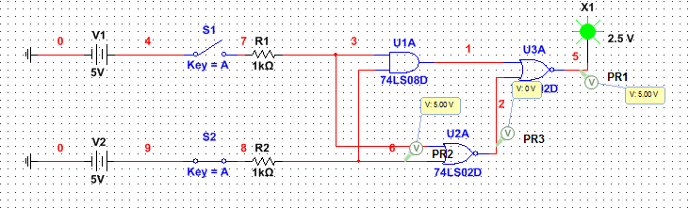
0-1

Slide 7
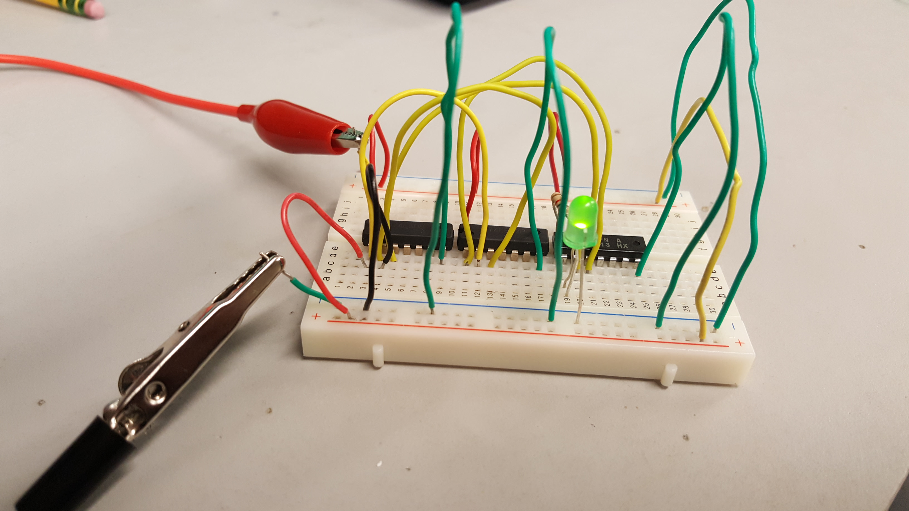
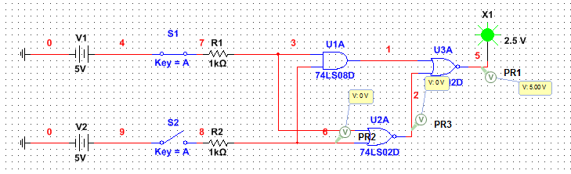
1-0

Slide 8
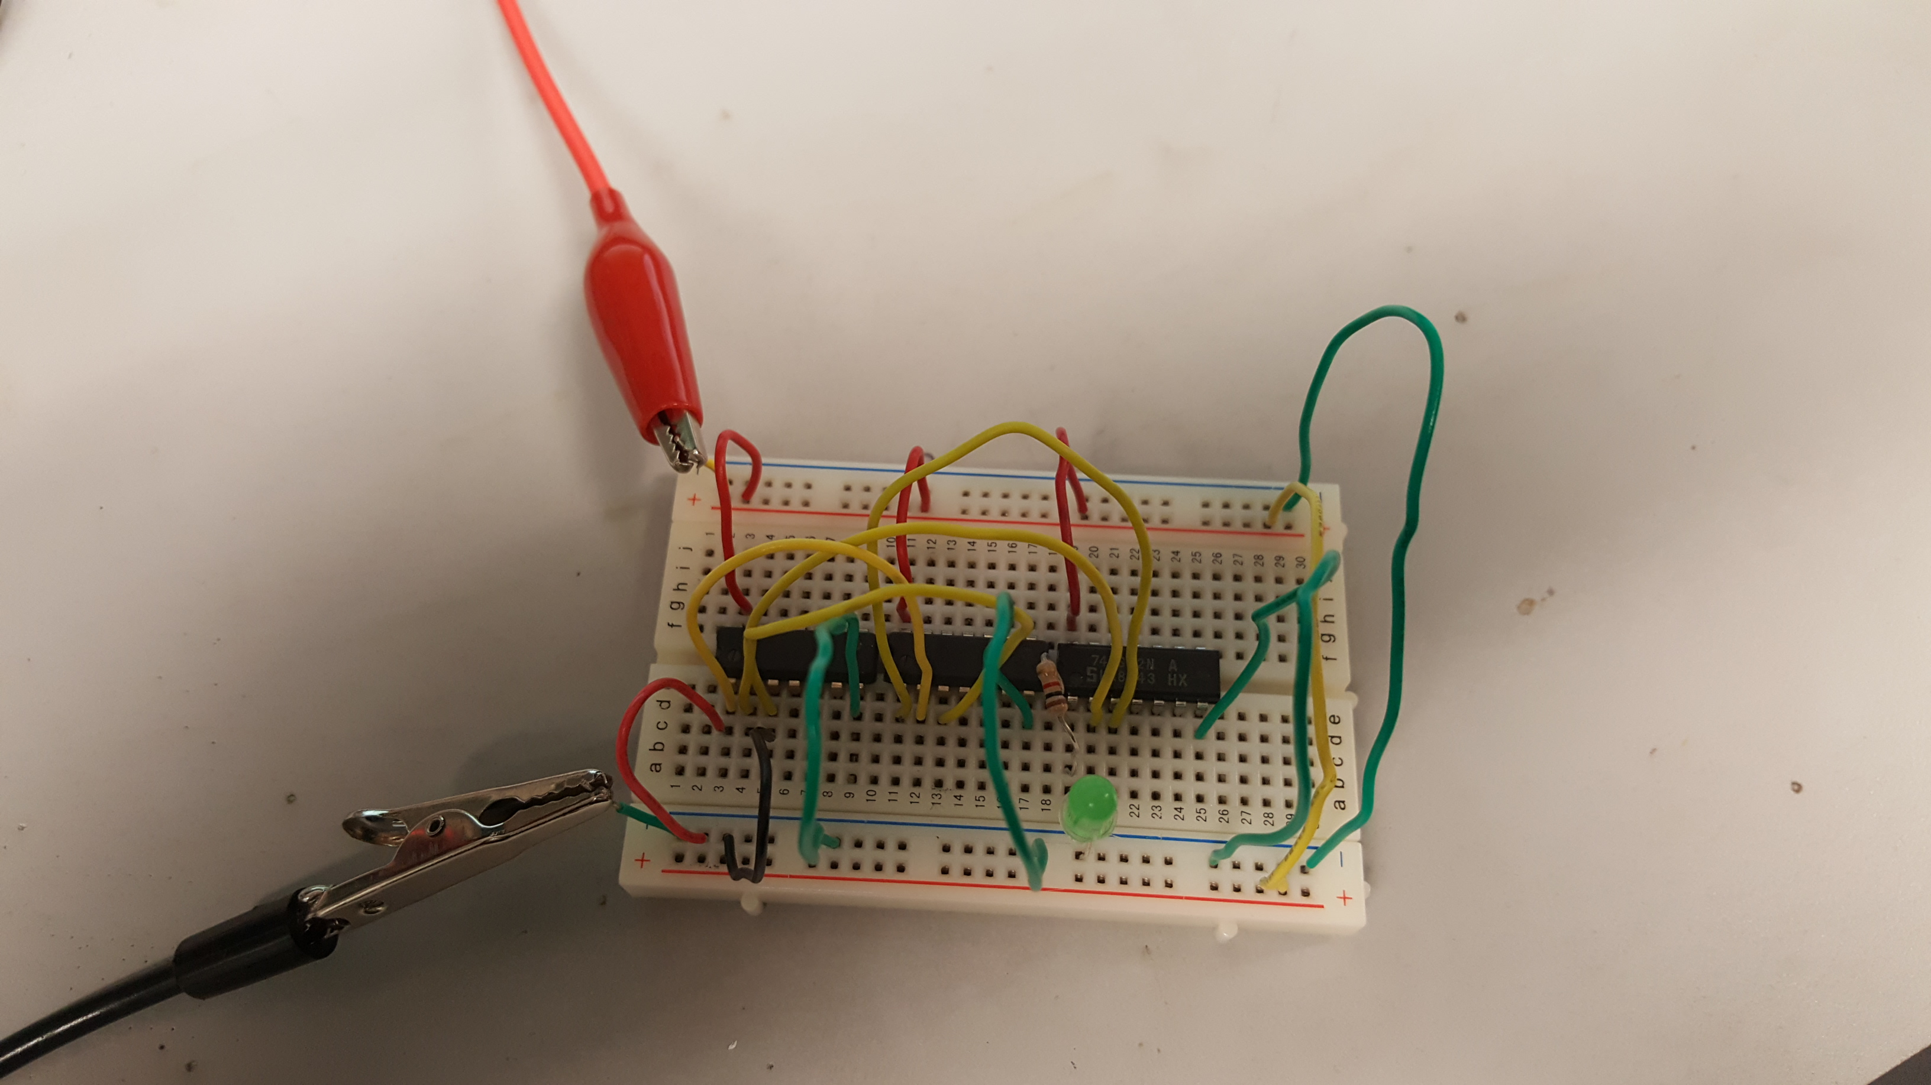
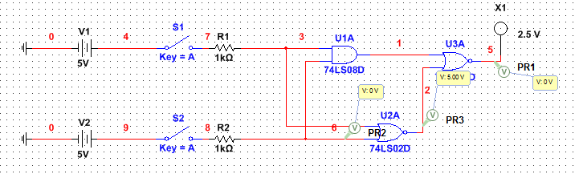
0-0

Slide 9
Table 1 - Simulation and Test
Simulated (Input) |  | Results | Test (Input) |  | Results
A | B |  | A | B
0 | 0 | 0 | 0 | 0 | 0
0 | 1 | 1 | 0 | 1 | 1
1 | 0 | 1 | 1 | 0 | 1
1 | 1 | 0 | 1 | 1 | 0

Slide 10
Observation:
In this lab we observed the results of ganging 3 separate gates together. We used one AND gate and 2 NOR gates and one 1 kΩ resistor to turn on an LED light. After simulating in Multi-Sim we built the circuit in the lab and our results matched up with the simulation. We ganged the gates together according to the data sheets and applied 5 DC volts. When both inputs were high or both low the LED was not illuminated. However, when one was high and the other low the LED was illuminated.

Slide 11
Equipment Used
Bench 4
DC Power Supply – HY1802D
Multimeter – GDM-8245
1 kΩ resistor - Measured at 0.9855 kΩ
1 – 74LS08 AND GATE
2 – 74LS02 NOR GATE
1 – 08LX330 HV5 – LED LIGHT

Slide 12
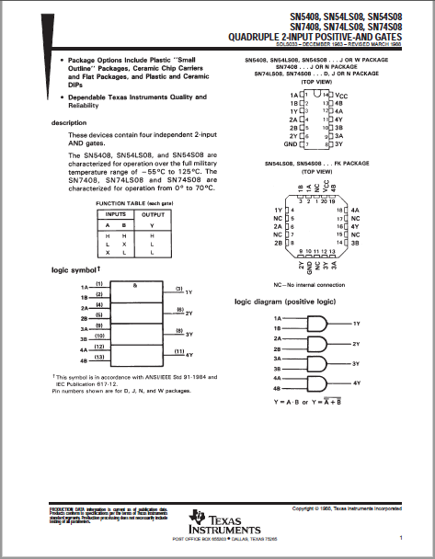
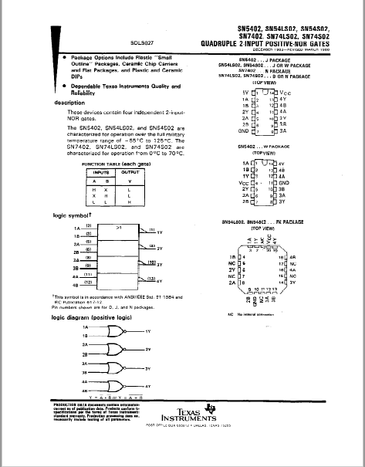
DATA Sheets:

Slide 13
References:
http://www.ivytechengineering.com/info/stores/74ls/files/74ls08.pdf
http://www.ivytechengineering.com/info/stores/74ls/files/74ls02.pdf

